Slide 1

Balanced scorecard slide 1
Modeling Disease Spread and Health Behavior Diffusion through Clustering and Social Network Exposure
HSN-619 (Project Assignment)
2024-25 Autumn

Slide 2
OUTLINE
INTRODUCTION
SUMMARY OF BASE PAPERS
LITERATURE REVIEW
DATA AND MEASURES
THEORETICAL FRAMEWORKS
RESULTS
PUBLIC HEALTH IMPLICATIONS
CONCLUSION
REFERENCES

Slide 3
INTRODUCTION
The dynamics of infectious disease spread and the prevalence of chronic conditions are multifaceted issues influenced by a variety of factors, including socioeconomic status, social networks, and individual health behaviors.
This report presents a comprehensive exploration of these dynamics through four distinct analyses, each addressing a critical aspect of disease transmission.
The traditional models, such as the SIR (Susceptible-Infectious-Recovered) framework, often fail to account for the complexity of social networks that influence not only the rate of transmission but also the reach of health behaviors across socioeconomic classes.
The motivation behind this study is to extend these classical models by incorporating Social Network Exposure (SNE) and economic connectedness into the analysis of disease transmission and health behavior diffusion.

Slide 4
SUMMARY OF FIRST BASE PAPER
The first paper is Social Capital I: Measurement and Associations with Economic Mobility by Raj Chetty et al.
Key Findings
Defining Social Capital
Economic Connectedness (EC): This measures the extent to which people from low and high socioeconomic statuses(SES) are connected. It’s calculated as the share of high-SES friends among low-SES individuals, normalized by the overall share of high-SES individuals.
Network Cohesiveness: This focuses on the structure of social networks, particularly the presence of cliques and the extent to which friendships are reciprocated. It is measured by clustering coefficient, support ratio, and spectral homophily.
Civic Engagement: Measured using indicators like volunteering rates, participation in civic organizations, and levels of trust.
• Geographical Variation: All three measures of social capital show significant variation across US counties.
• Economic Connectedness and Mobility: The study finds a strong positive association between EC and upward income mobility. Children from low-income families who grow up in areas with higher EC tend to have higher incomes in adulthood. The study estimates that if children with low-SES parents grew up in counties with EC comparable to that of the average child with high-SES parents, their adult incomes would increase by 20% on average.
• Other Social Capital Measures: Network cohesiveness and civic engagement measures show weaker and less consistent correlations with economic mobility. For example, while civic engagement tends to be higher in rural areas, it is more weakly correlated with economic mobility once the data is weighted to account for the greater concentration of low-income families in urban communities.

Slide 5
SUMMARY OF SECOND BASE PAPER
The second paper is Social Capital II: Determinants of Economic Connectedness by Raj Chetty et al.
Decomposing Economic Connectedness
Key Findings
Exposure and Bias Contribute Equally: Both exposure and friending bias play significant roles in shaping EC, each explaining roughly half of the variation in the share of high-SES friends between low- and high-SES individuals.
Context Matters: The level of friending bias varies substantially across different social settings. For instance, friend-ing bias tends to be lower in religious organizations compared to schools or workplaces.
Exposure: The extent to which individuals from different SES backgrounds are present in the same social settings(e.g., schools, religious organizations, workplaces). The study finds that approximately half of the difference between low and high-SES people is due to differences in exposure.
Friending Bias: The tendency for individuals to form friendships with others from similar SES backgrounds, even when controlling for the level of exposure to people from different SES groups within a given setting. The study finds that friending bias is more pronounced in larger, more diverse high schools.
Policy Implications
Integration for Low Bias: In settings with low friending bias, increasing socioeconomic integration (exposure) can effectively boost EC.
Addressing Bias Directly: In settings with high friending bias, interventions should focus on reducing bias within existing groups to promote cross-SES friendships.

Slide 6
Literature Review
Year | Title | Author(s) | Summary
2023 | Spatially Explicit Effective Reproduction Numbers from Incidence and Mobility Data | Cristiano Trevisin et al. | Proposes a method to estimate spatially explicit reproduction numbers Rk(t)R_k(t)Rk​(t), incorporating mobility data across interconnected communities. The method improves understanding of disease transmission dynamics by accounting for mobility fluxes.
2021 | Cryptic Transmission of SARS-CoV-2 and the First COVID-19 Wave in Europe and the United States | Jessica T. Davis et al. | Uses a global metapopulation model to show the undetected spread of SARS-CoV-2 during the early pandemic due to limited testing. The study emphasizes the role of international travel in spreading the virus.
2021 | Modeling the Interplay Between Demography, Social Contact Patterns, and SARS-CoV-2 Transmission in the South-West Shewa Zone of Oromia Region, Ethiopia | Filippo Trentini et al. | Simulates COVID-19 spread in Ethiopia using social contact data from various settings. The study shows higher infection rates in urban areas but more severe disease in rural regions, influenced by demographic and social factors.
2021 | On a Discrete-Time Network SIS Model with Opinion Dynamics | Weihao Xuan et al. | Introduces a discrete-time SIS model integrated with opinion dynamics to explore how individuals' perceptions of disease severity affect transmission within a network. Simulation results highlight the interaction between health perceptions and infection rates.
2019 | Reactive School Closure Weakens the Network of Social Interactions and Reduces the Spread of Influenza | Maria Litvinova et al. | Investigates the impact of school-closure policies on influenza spread by analyzing social interactions during school closures in Russia. The study used contact diaries and a hybrid survey-modeling framework to demonstrate significant reductions in contacts and infection rates.
2018 | Measurability of the Epidemic Reproduction Number in Data-Driven Contact Networks | Quan-Hui Liu et al. | Explores the limitations of the basic reproduction number, R0R_0R0​, in heterogeneous real-world networks, proposing the time-varying reproduction number R(t)R(t)R(t) to better capture epidemic dynamics using multiplex networks in Italian and Dutch populations.
2017 | Spread of Zika Virus in the Americas | Qian Zhang et al. | Analyzes the spatial and temporal dynamics of the Zika virus using the GLEAM model, integrating demographic and mobility data. Findings reveal slow growth and heterogeneity in the epidemic due to vector dynamics and human movement.
2016 | How Social Structures, Space, and Behaviors Shape the Spread of Infectious Diseases Using Chikungunya as a Case Study | Henrik Salje et al. | Uses the chikungunya outbreak in Bangladesh to assess the impact of social interactions and spatial proximity on disease transmission, highlighting the role of household and neighborhood factors in shaping the epidemic.
2014 | The Representativeness of a European Multi-Center Network for Influenza-Like Illness Participatory Surveillance | Pietro Cantarelli et al. | Evaluates the representativeness of Influenzanet, a European online participatory surveillance system for influenza, identifying demographic biases and underrepresentation of certain population groups such as smokers and the elderly.
2009 | Percolation and Epidemics in Random Clustered Networks | Joel C. Miller | Examines percolation and epidemic dynamics in clustered networks, showing that clustering increases the epidemic threshold and reduces component sizes compared to un-clustered networks.

Slide 7
Data used in the Base Papers
Dataset Overview:
21 billion friendship links between Facebook users aged 25-44 in the U.S.
Focus on this age group due to high Facebook usage (80%) and comparability with American Community Survey (ACS) demographic data.
User Information:
Facebook profile data includes age, gender, ZIP code, county, relationship status, education, donations, phone model, mobile carrier, device usage, familial ties, and group memberships.
Socioeconomic status (SES) is constructed using this data.
Parental SES and Group-Level Data:
Family SES during childhood is derived from self-reported family connections, names, posts, and life events.
Friendships are categorized by shared affiliations, such as schools, employers, neighborhoods, and recreational groups.
External Datasets:
American Community Survey (ACS): Median incomes, racial/ethnic demographics, and community characteristics.
Opportunity Atlas: Data on income mobility, graduation rates, birth rates.
NCES and CRDC: School-level variables.
IPEDS: College-level data.
Census Data: Used for determining the population with below-national-median parental income for weighting.

Slide 8
Statistical Analysis and Measures
This report primarily focuses on theoretical frameworks to understand the dynamics of infectious disease transmission. Simulations have been conducted to illustrate the model outcomes and validate the theoretical constructs. The simulations were implemented using Python, with the accompanying code provided in the attached folder. This computational approach allows for the exploration of various scenarios and the assessment of the impact of different variables on disease dynamics. The authors calculated the exposure and clustering coefficient, which are utilized in this paper
Infection Population: Measured as the number of individuals currently infected at a given time, expressed per 1,000 individuals in the population.
Susceptible Population: Defined as the number of individuals who are not infected and are at risk of contracting the disease.
Latent Period: The duration during which individuals are infected but not yet infectious. This period is crucial for understanding the dynamics of disease spread.
Social Network Exposure (SNE): Quantified based on the density of social ties within communities, measured through network analysis techniques. The SNE ranges from 0 to 1, where higher values indicate greater social andeconomic connectedness.
Clustering Coefficient: Calculated to assess the degree of interconnectedness among individuals within social networks. Like SNE, the clustering coefficient ranges from 0 to 1, with higher values reflecting more tightly-knit social groups.

Slide 9
THEORETICAL FRAMEWORKS

Slide 10
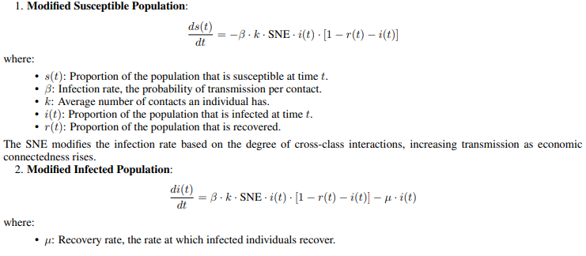
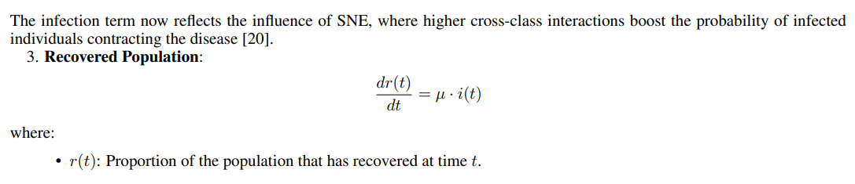
Analysis 1: Economic Connectedness and Disease Spread
Existing Theory: The Strength of Weak Ties Granovetter’s (1973) theory emphasizes that weak ties, or connections between individuals from different socioeconomic backgrounds, play a critical role in spreading information. Applied to disease transmission, these cross-class ties enable broader and faster infection spread by linking otherwise isolated social groups. In contrast, strong homophily (friending bias) limits cross-group transmission, leading to more contained outbreaks.
Extension: Social Network Exposure (SNE) in the SIR Model To model economic connectedness, we introduce Social Network Exposure (SNE) into the SIR (Susceptible-Infectious-Recovered) model. SNE quantifies cross-class interactions, influencing infection rates. Higher SNE values reflect more frequent interactions between socioeconomic groups, accelerating disease spread, while lower SNE indicates stronger friending bias, limiting cross-group infections.

Slide 11
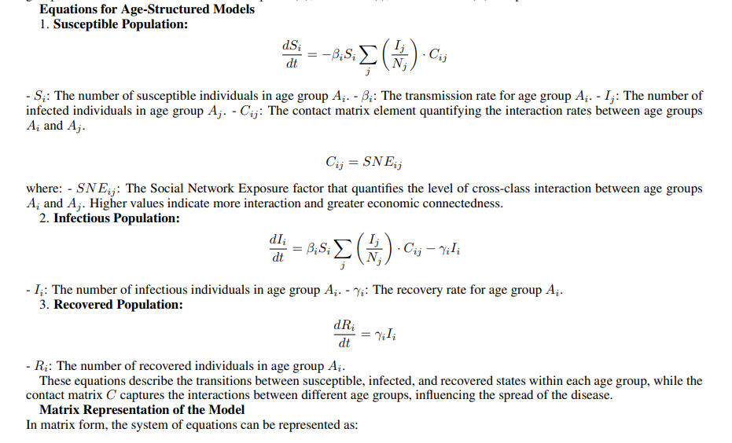
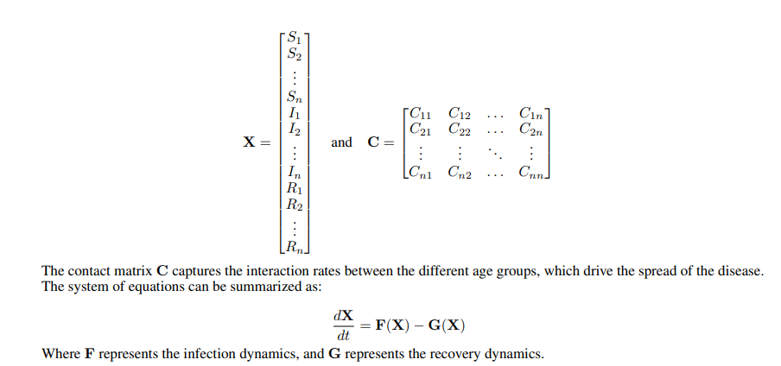
Analysis 2: Age-Structured Models for Understanding Infectious Disease Dynamics
Age-structured models are essential for studying infectious diseases as they account for variations in transmission rates, susceptibility, and recovery across different age groups. By segmenting populations by age, these models provide a nuanced understanding of disease dynamics and facilitate the design of targeted interventions.
Population Segmentation:
Infection Rates: Younger individuals often have higher contact rates (e.g., through schools), increasing transmission potential, while older individuals may face more severe outcomes.
Recovery Rates: Recovery varies by age, with younger individuals generally recovering faster due to differences in immune response.
Contact Patterns: The model considers interaction frequencies, such as children having more close contacts with peers, while older adults may engage in fewer but higher-risk interactions.
Dynamic Interactions: These models simulate interactions between age groups, enabling the study of disease spread over time based on differing infection and recovery rates.

Slide 12
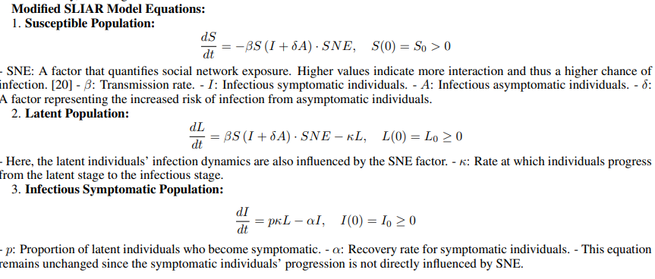
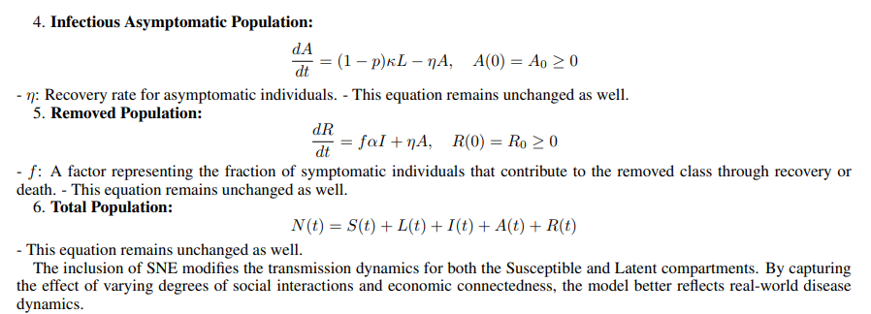
Analysis 3: SLIAR Model with Social Network Exposure (SNE) for Infectious Disease Dynamics
The SLIAR model is an extension of the traditional SIR (Susceptible-Infectious-Recovered) framework, adding compartments to capture latent and asymptomatic stages of infection.
1. Compartment Definitions:
S (Susceptible): Individuals who are not infected and can become infected.
L (Latent): Infected individuals who are not yet infectious and cannot transmit the disease.
I (Infectious Symptomatic): Infected individuals displaying symptoms who can spread the disease.
A (Infectious Asymptomatic): Infected individuals without symptoms who can still transmit the disease.
R (Removed): Individuals who have recovered with immunity or have died, thus unable to spread the disease.
2. Incorporation of Social Network Exposure (SNE): To enhance the SLIAR model, we modify the equations to include Social Network Exposure (SNE), reflecting the impact of cross-class interactions on disease transmission dynamics. The SNE variable influences infection rates based on social interactions within the community.

Slide 13
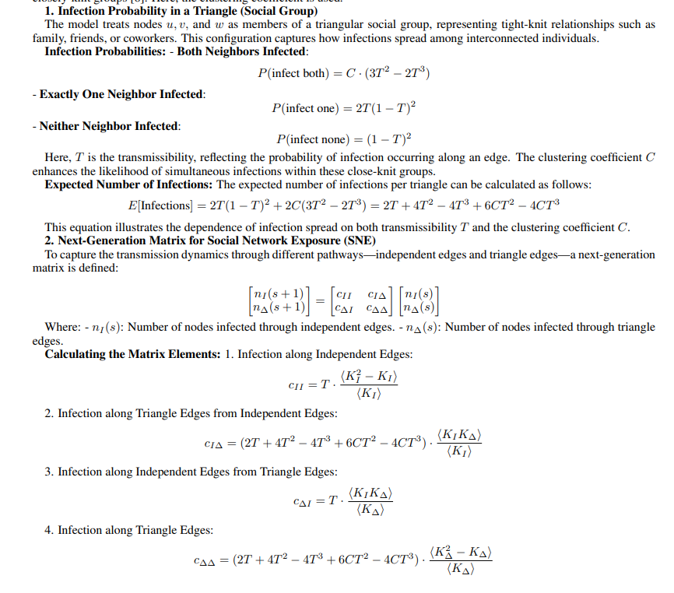
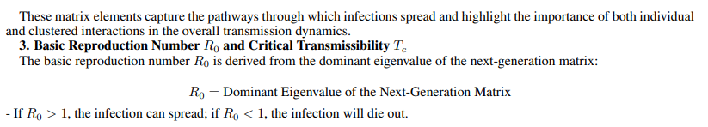
Analysis 4: Clustered Network Epidemics via Incorporating Social Interactions
This approach is particularly relevant in studying how social interactions influence the spread of infectious diseases among closely-knit groups. Here, the clustering coefficient is used, which is calculated to assess the degree of interconnectedness among individuals within social networks.

Slide 14
RESULTS

Slide 15
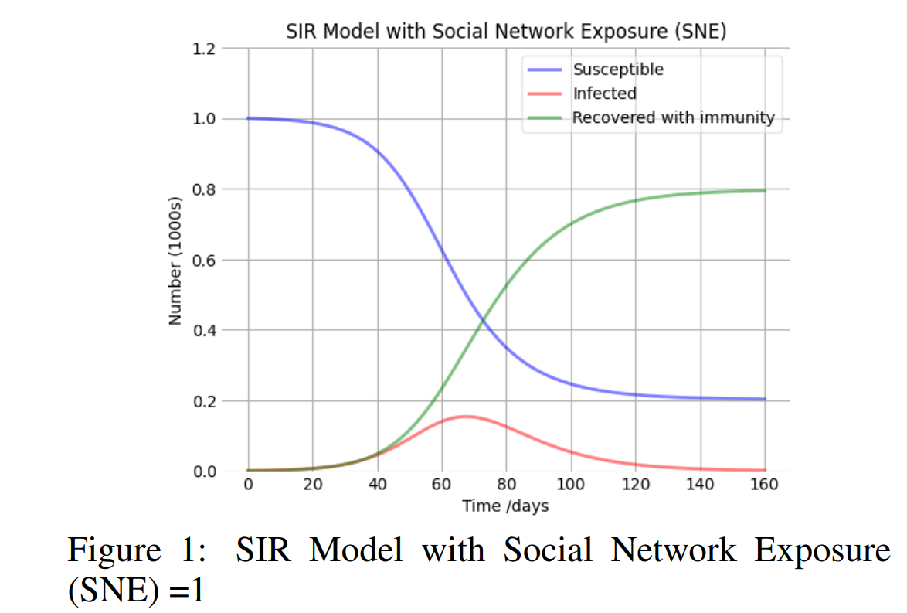
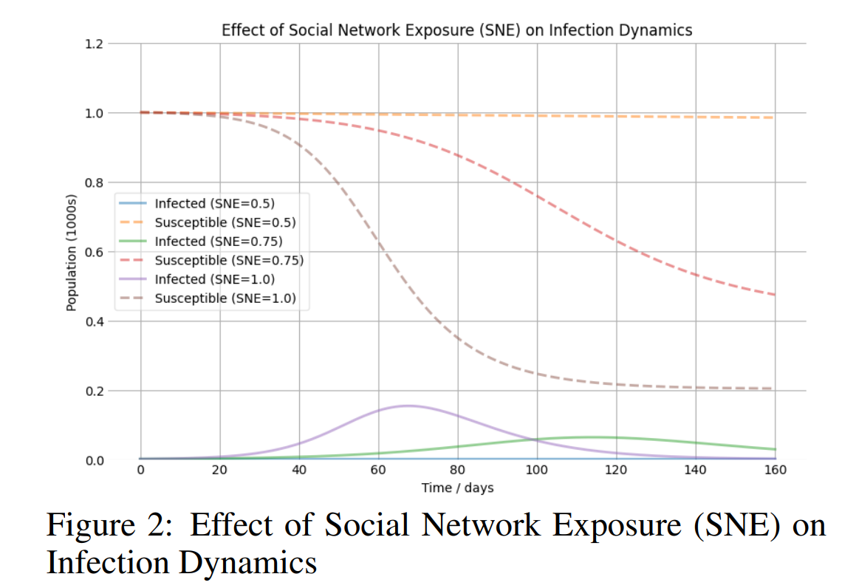
Analysis 1: Economic Connectedness and Disease Spread
Figure 1: SIR Model with Social Network Exposure (SNE) =1
Figure 2: Effect of Social Network Exposure (SNE) on Infection Dynamics
In regions with high economic connectedness (low friending bias), disease spreads rapidly across socioeconomic groups, leading to an earlier peak in infections and a faster decline in susceptible individuals, as shown in Figure 2. This accelerated transmission strains healthcare resources sooner, requiring prompt interventions. Conversely, in areas with high friending bias (low economic connectedness), outbreaks are more localized within socioeconomic groups, resulting in slower, stratified transmission. This delays the infection peak and causes a more gradual decline in susceptible individuals.
Notes:
The simulation of the SIR model with Social Network Exposure (SNE) as shown in Figure 1 was conducted using Python with a total population of 1,000 individuals. Initially, there was 1 infected individual and 0 recovered individuals, resulting in 999 susceptible individuals. The contact rate (β) was set at 0.2, while the mean recovery rate (γ) was 1/10, indicating an average recovery time of 10 days. The SNE factor was fixed at 1, reflecting maximum social network exposure. The simulation spanned 160 days, with time points generated at 1-day intervals using ‘numpy.linspace‘. The SIR model equations were modified to incorporate SNE, and the resulting differential equations were solved using the ‘odeint‘ function from the ‘scipy.integrate‘ library to assess the impact of social interactions on disease dynamics. Figure 2 is obtained by changing SNE.

Slide 16
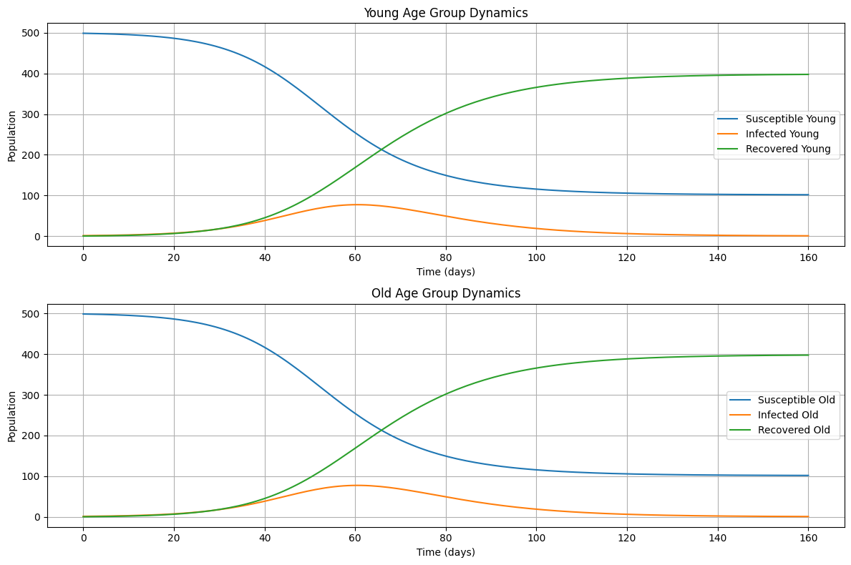
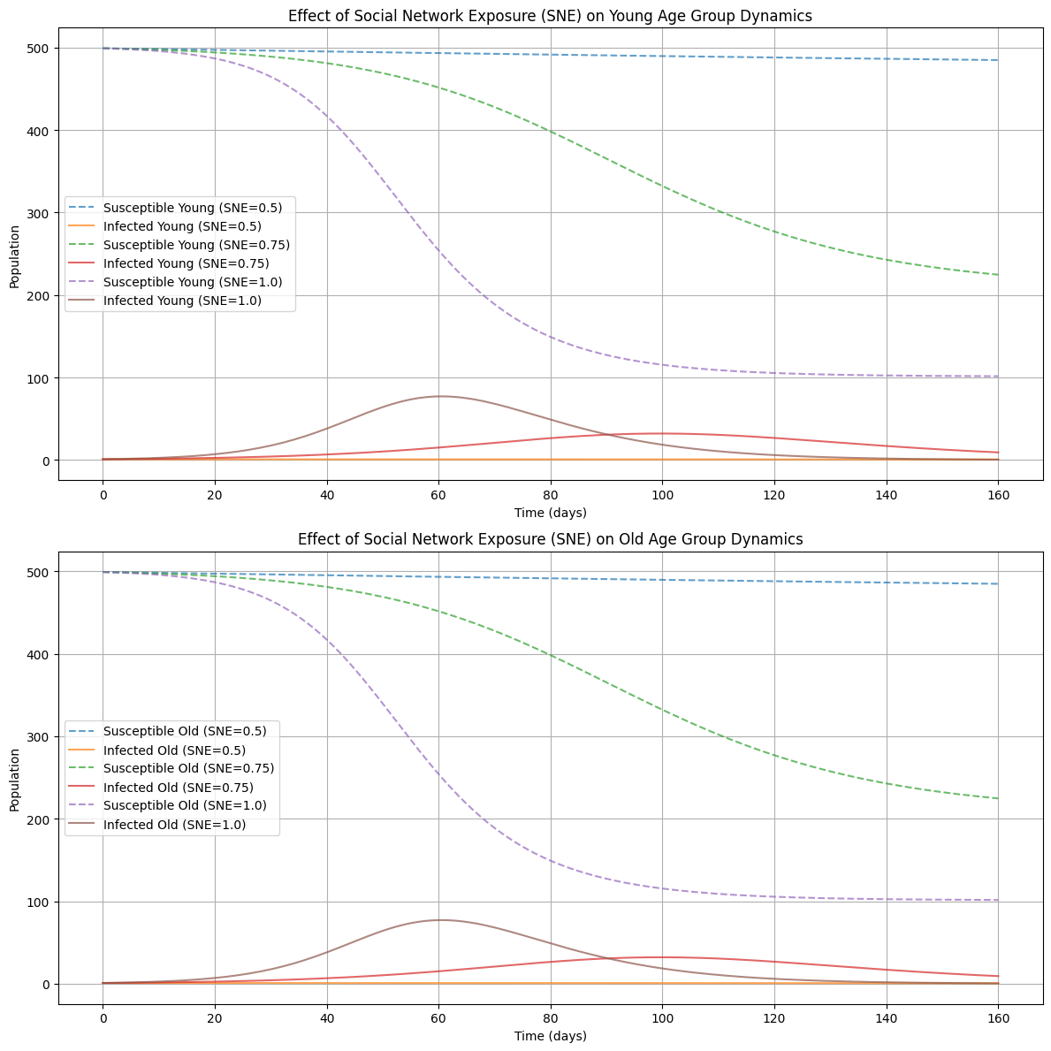
Analysis 2: Age-Structured Models for Understanding Infectious Disease Dynamics
Figure 3: SIR Model with Young and Old Age Group Dynamics with SNE =1
Figure 4: Effect of SNE on Infection Dynamics in Young and Old Age Group SIR Model
Higher Social Network Exposure (SNE) increases cross-class interactions, leading to faster disease transmission and earlier infection peaks across age groups, as shown in Figure 4. This acceleration of transmission is particularly evident when younger individuals, often in schools or community settings, have more frequent contact with older adults, heightening the risk of rapid disease spread. As a result, public health systems must prepare for surges in cases earlier than anticipated, requiring swift response measures. Additionally, changes in SNE can highlight vulnerabilities in certain age groups, especially older adults who may be exposed to younger, asymptomatic carriers. The distribution of risk shifts accordingly, necessitating targeted monitoring and intervention.
Notes:
The age-structured model simulation, as shown in Figure 3, was executed using Python with a total population of 1,000 individuals, evenly divided between two age groups: young and old. Initial conditions included 1 infected individual in each age group, with zero recovered individuals. The susceptible populations were calculated as follows: the young susceptible population was set to Sy = 499 (i.e., half of the population minus the infected), and the old susceptible population was set to So = 499. Contact rates varied between age groups, with the transmission rate for the young set at 0.3 and for the old at 0.1. The mean recovery rate for both groups was defined as 1 10 and 1 10 respectively, indicating an average recovery period of 10 days. The Social Network Exposure (SNE) factor was fixed at 1, signifying maximum exposure. The simulation ran for 160 days, using time points generated at 1-day intervals with ‘numpy.linspace‘. The resulting differential equations were solved using the ‘odeint‘ function from the ‘scipy.integrate‘ library, allowing for the assessment of disease dynamics across age groups and the influence of social interactions. Figure 4 is obtained by changing SNE.

Slide 17
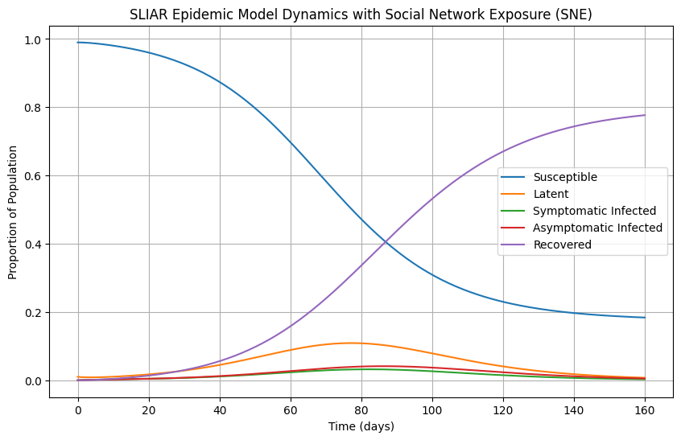
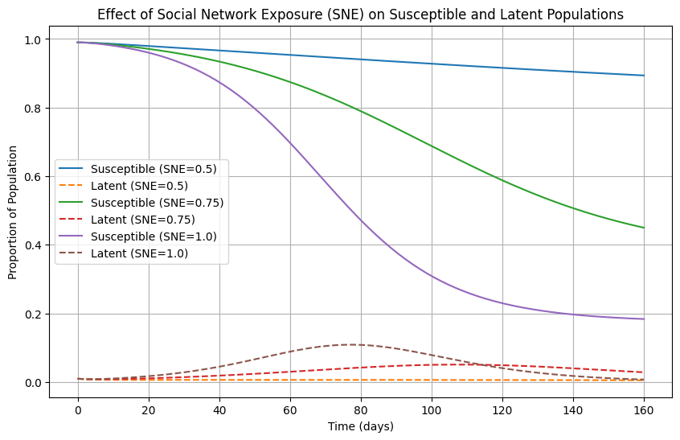
Analysis 3: SLIAR Model with Social Network Exposure (SNE) for Infectious Disease Dynamics
Figure 5: SLIAR Epidemic Model Dynamics with SNE = 1
Figure 6: Effect of Social Network Exposure (SNE) on SLIAR Epidemic Model Dynamics
Higher Social Network Exposure (SNE) leads to more frequent interactions across socioeconomic groups, resulting in increased infection rates as individuals rapidly move from the susceptible (S) to latent (L) and infectious (I, A) compartments, as shown in Figure 6. This accelerates disease transmission, particularly among asymptomatic carriers, and drives an earlier peak in infections, putting additional pressure on healthcare systems. Shortened latent and infectious periods further speed up the spread, while asymptomatic individuals contribute significantly to undetected transmission. Different age groups face varying vulnerabilities, with younger populations becoming key transmitters. High SNE also leads to localized outbreaks across socioeconomic groups, complicating containment efforts, whereas low SNE confines outbreaks within specific classes.
Notes:
The simulation of the SLIAR model with Social Network Exposure (SNE) as shown in Figure 5 was conducted using Python, employing a transmission rate of 0.5 and an infectivity reduction rate for asymptomatic individuals set at 0.3. The transition rate from latent to infected was defined as 0.1, while the recovery rate for symptomatic infections was set at 0.2. The proportion of latent individuals progressing to symptomatic infections was established at 0.6, with a recovery rate for symptomatic individuals fixed at 0.95. Asymptomatic individuals had a recovery rate of 0.1. The SNE factor was fixed at 1.0, indicating full exposure. Initial conditions included 99% of the population as susceptible, 1% as latent, and none as symptomatic, asymptomatic, or recovered. The simulation spanned 160 days, with time points generated at 1-day intervals, and the differential equations were solved using the ‘odeint‘ function from the ‘scipy.integrate‘ library. Figure 6 is obtained by changing SNE.

Slide 18
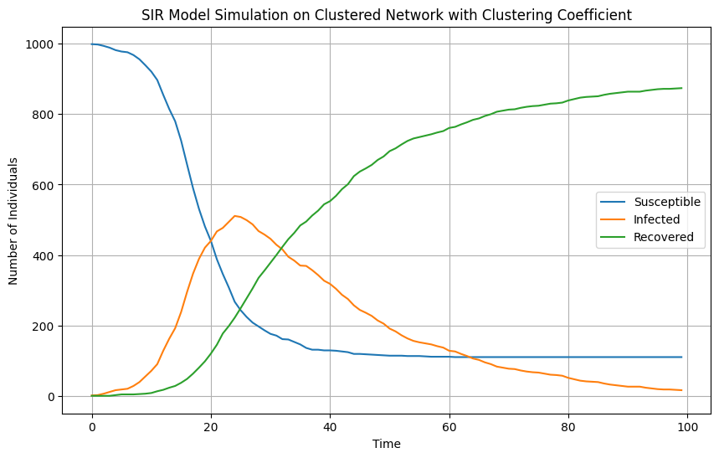
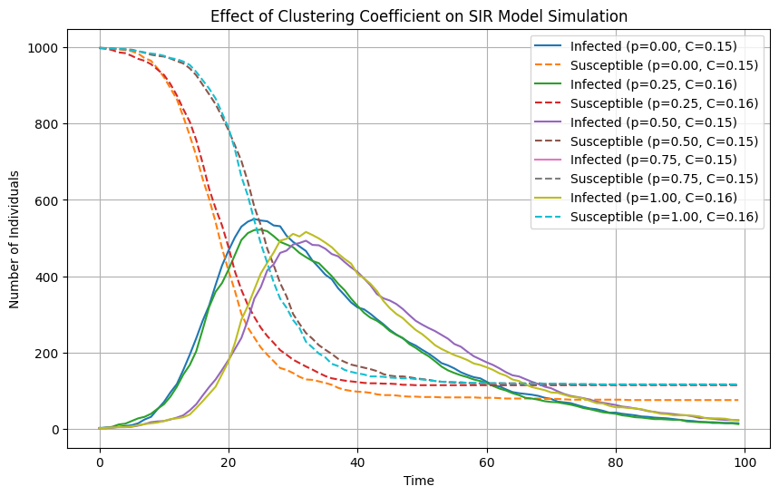
Analysis 4: Clustered Network Epidemics via Incorporating Social Interactions
Figure 7: SIR Model Simulation on Clustered Network with Clustering Coefficient
Figure 8: Effect of Clustering Coefficient on SIR Model Simulation of Clustered Network
The Clustering Effect on Infection Spread shows that at p = 0.00, infections quickly die out. As p increases (e.g., 0.25, 0.50, 0.75, 1.00), infections peak before declining, indicating that higher infection probabilities lead to faster, more widespread transmission (Figure 8). A larger clustering coefficient (C = 0.16) prolongs the infection duration due to more efficient spread within closely connected social groups, while lower clustering results in quicker but shorter epidemics. Social Interactions play a crucial role—higher clustering keeps infections active longer, while higher infection probabilities p increase the epidemic’s peak magnitude.
Notes:
For Figure 7, a clustered network consisting of 1,000 nodes was generated, where the probability of forming triangle connections was set at 0.3. The degree distribution for independent edges was modeled using a Poisson distribution with a mean of 2, while triangle edges had a mean of 1. The infection probability was 0.1, and the recovery probability was set at 0.05. One node was randomly selected as the initial infected individual, and the simulation was run for a maximum of 100-time steps, plotting the number of susceptible, infected, and recovered individuals over time. For Figure 8, the same parameters were used, but the clustering coefficient of the network was explicitly incorporated into the infection dynamics. The clustering coefficient was calculated based on the average connections in the network, influencing the likelihood of infection spread between tightly connected groups

Slide 19
Public Health Implications
Targeted Interventions: Public health efforts should prioritize vaccination for high-risk groups identified through Social Network Exposure (SNE) analysis, particularly younger populations acting as key transmitters. Tailored health education campaigns should raise awareness about inter-age group risks and promote preventive measures in high-SNE settings.
Flexible Response Strategies: Public health responses must be adaptive to changes in SNE, implementing temporary restrictions or enhanced measures during community events. Real-time monitoring of SNE can allow for more proactive strategies, enabling health officials to respond dynamically to evolving conditions.
Community Engagement: Encouraging cross-class interactions can strengthen community resilience to outbreaks. Public policies should support initiatives that promote inter-socioeconomic interactions, alongside providing essential support services like transportation for older adults to healthcare facilities.
Resource Allocation: Healthcare resources should be allocated based on age-specific risk and SNE patterns. High-SNE areas may require increased medical support due to faster transmission rates, while strategic healthcare infrastructure planning should account for potential spikes in infections among populations frequently interacting across age groups.

Slide 20
Conclusion
The research presented in this paper highlights the critical role of social network exposure (SNE), connectedness, clustering coefficient, and age-structured dynamics in understanding and mitigating the spread of infectious diseases.
1
By extending traditional models such as SIR and SLIAR to incorporate SNE, this study demonstrates how cross-class and inter-age interactions accelerate disease transmission, leading to different public health outcomes in various socioeconomic contexts.
2
The simulations of clustered network epidemics further emphasize the influence of social interactions and clustering on the spread of infections, providing insights into how closely connected groups may sustain transmission longer.
3
The findings underscore need for adaptive and targeted public health strategies, with interventions tailored to specific population dynamics & network structures. These insights have significant implications for vaccine distribution, resource allocation, & community engagement initiatives.
4
Future research should focus on refining models with real-world data to validate the findings & explore additional factors, like mobility patterns and health behaviors, A deeper understanding of how social structures impact epidemic spread can inform more efficient public health policies.
5

Slide 21
References
[1] L. F. Berkman and T. Glass, “Social integration, social networks, social support, and health,” in Social Epidemiology. Oxford University Press, 2000.
[2] M. Marmot, “Social determinants of health inequalities,” The Lancet, vol. 365, no. 9464, pp. 1099–1104, 2005. [Online]. Available: https://doi.org/10.1016/S0140-6736(05)71146-6
[3] A. V. Diez Roux, “Investigating neighborhood and area effects on health,” American Journal of Public Health, vol. 91, no. 11, pp. 1783–1789, 2001. [Online]. Available: https://doi.org/10.2105/AJPH.91.11.1783
[4] W. O. Kermack and A. G. McKendrick, “A contribution to the mathematical theory of epidemics,” Proceedings of the Royal Society A: Mathematical, Physical and Engineering Sciences, vol. 115, no. 772, pp. 700–721, 1927. [Online]. Available: https://doi.org/10.1098/rspa.1927.0118
[5] M. S. Granovetter, “The strength of weak ties,” American Journal of Sociology, vol. 78, no. 6, pp. 1360–1380, 1973. [Online]. Available: https://doi.org/10.1086/225469
[6] O. Diekmann, H. A. P. Heesterbeek, and T. Britton, Mathematical Tools for Understanding Infectious Disease Dynamics. Princeton University Press, 2013.
[7] M. Ajelli and A. Vespignani, “The sliar model: a framework for modeling the dynamics of infectious diseases with latent and asymptomatic infections,” Journal of Theoretical Biology, vol. 266, no. 1, pp. 121–130, 2010.
[8] J. C. Miller, “Percolation and epidemics in random clustered networks,” Physical Review E, vol. 80, no. 2, p. 020901, 2009. [Online]. Available: https://doi.org/10.1103/PhysRevE.80.020901
[9] R. Chetty, M. O. Jackson, T. Kuchler, J. Stroebel, N. Hendren, R. B. Fluegge, S. Gong, F. Gonzalez, A. Grondin, M. Jacob, D. Johnston, M. Koenen, E. Laguna-Muggenburg, F. Mudekereza, T. Rutter, N. Thor, W. Townsend, R. Zhang, M. Bailey, P. Barbera, M. Bhole, and ´ N. Wernerfelt, “Social capital i: measurement and associations with economic mobility,” Nature, vol. 608, 2022. [Online]. Available: https://doi.org/10.1038/s41586-022-04996-4
[10] R. Chetty, M. O. Jackson, T. Kuchler, J. Stroebel, N. Hendren, R. B. Fluegge, S. Gong, F. Gonzalez, A. Grondin, M. Jacob, D. Johnston, M. Koenen, E. Laguna-Muggenburg, F. Mudekereza, T. Rutter, N. Thor, W. Townsend, R. Zhang, M. Bailey, P. Barber, M. Bhole, and N. Wernerfelt, “Social capital ii: determinants of economic connectedness,” Nature, vol. 608, 2022. [Online]. Available: https://doi.org/10.1038/s41586-022-04997-3

Slide 22
Balanced scorecard slide 10
THANK YOU
Divya Aggarwal
BS-MS Economics
21322011

